Slide 1
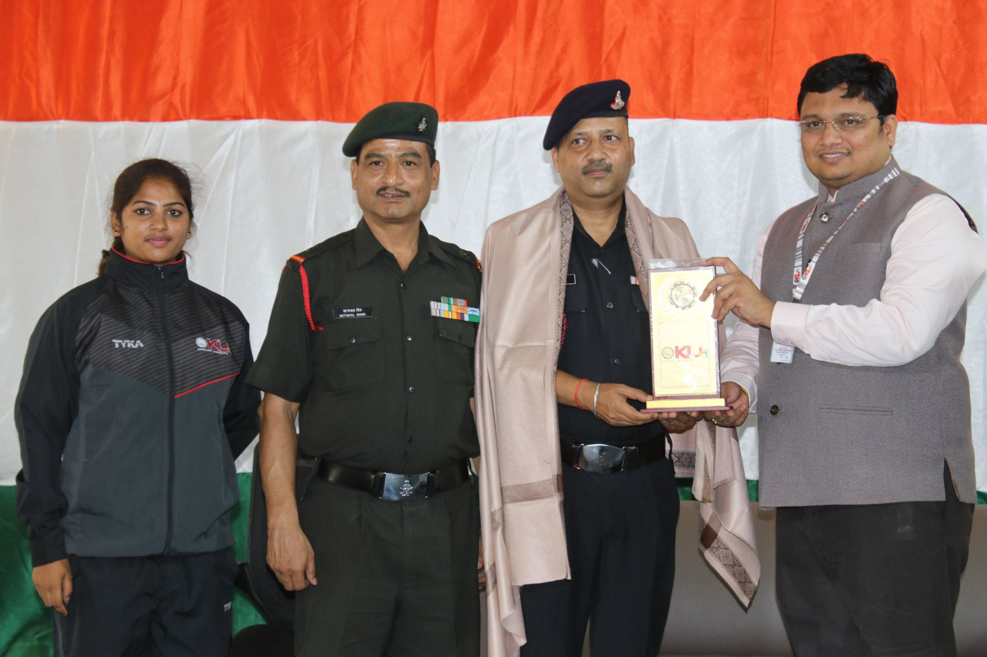
COL. PARSOON NATH THE ESTEEMED COMMANDING OFFICER OF 1(T) BN NCC.

Slide 2
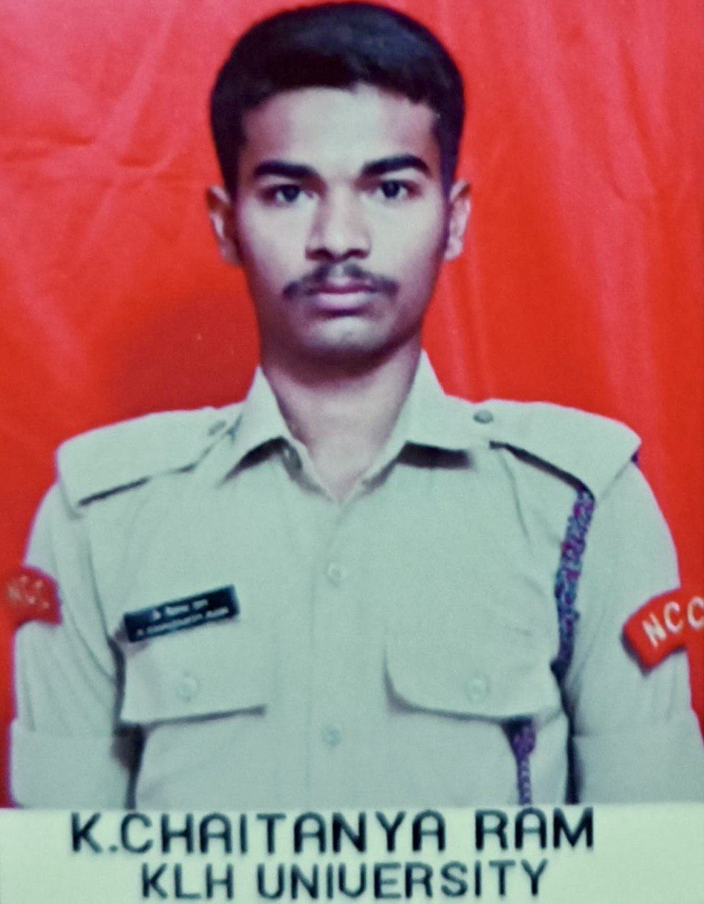
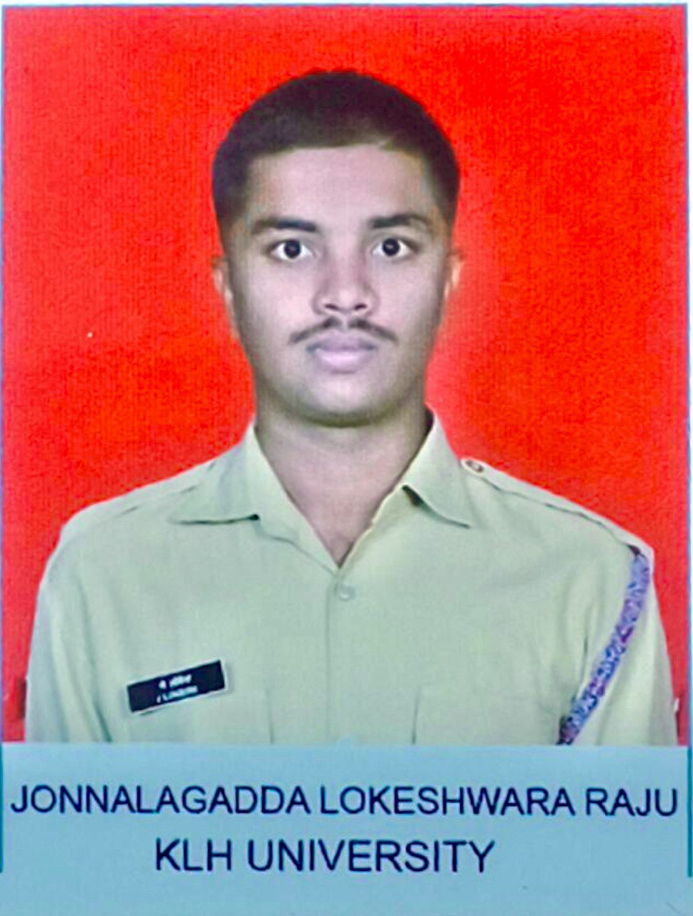
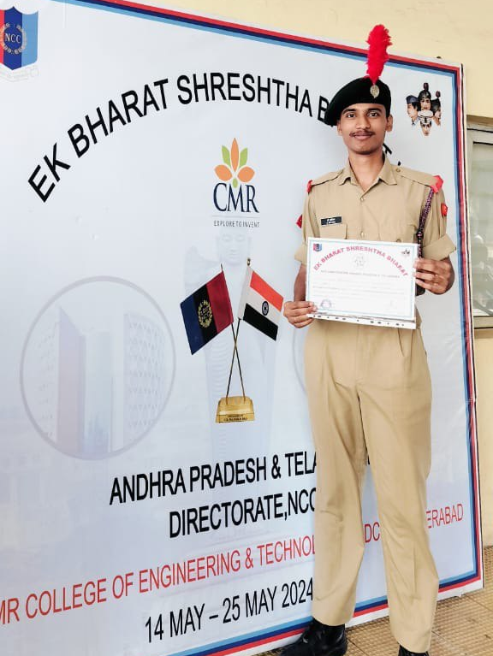
SENIORS (SD) CADETS OF KLH UNIVERSITY

Slide 3
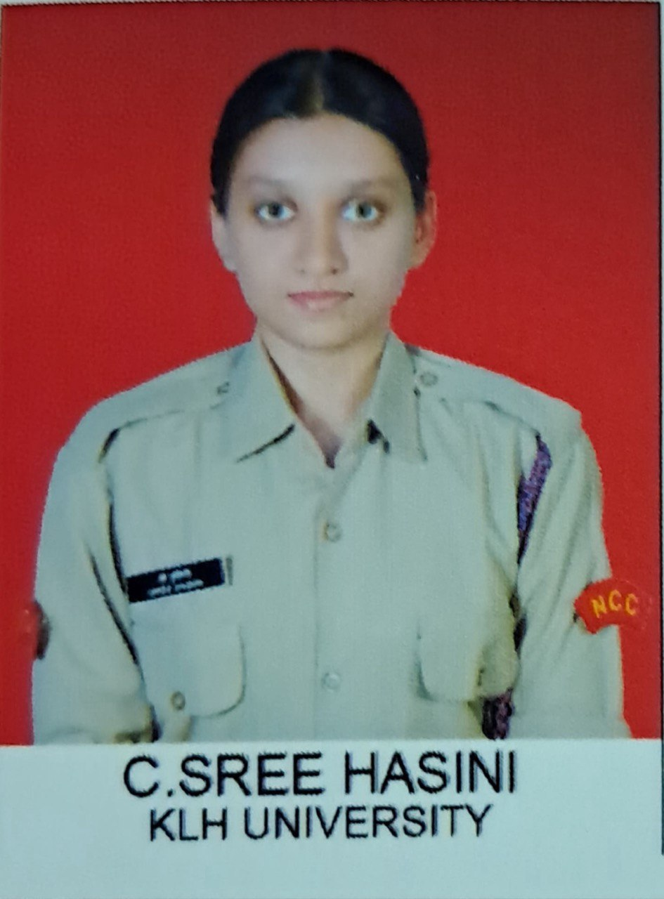
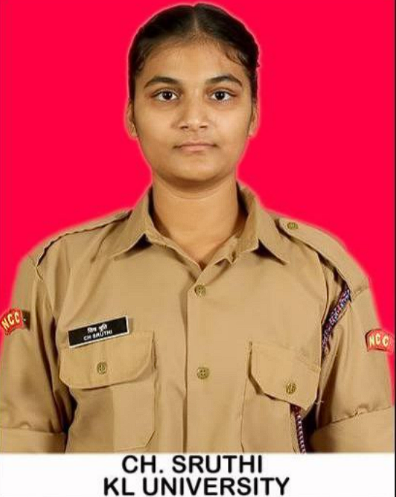
SENIORS (SW) CADETS OF KLH UNIVERSITY

Slide 4
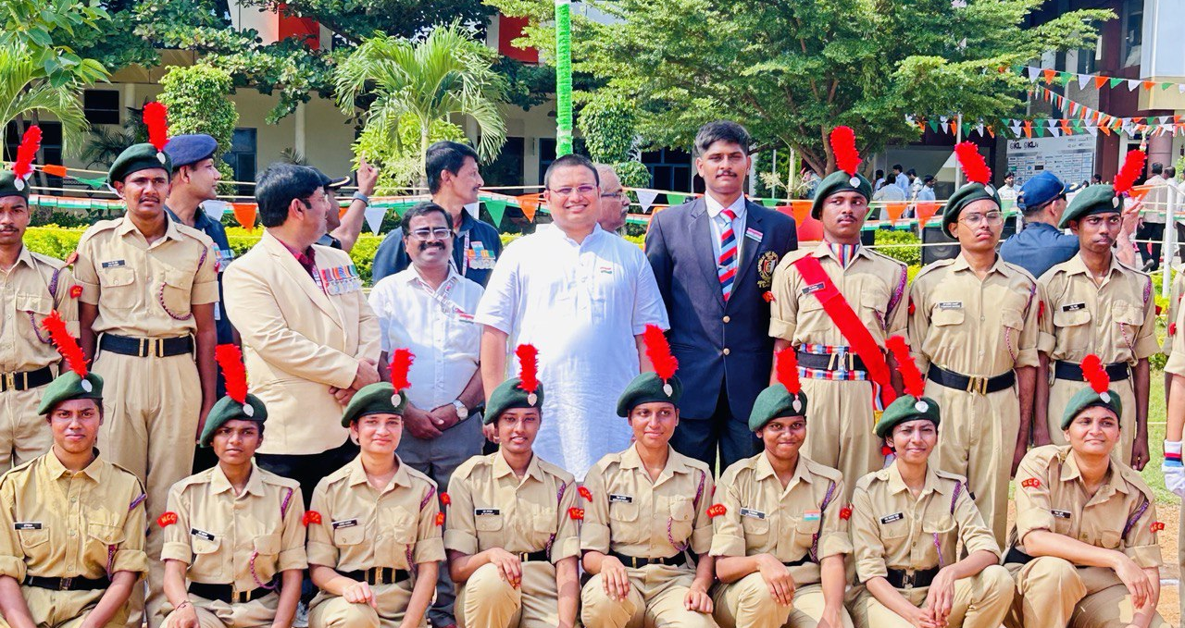
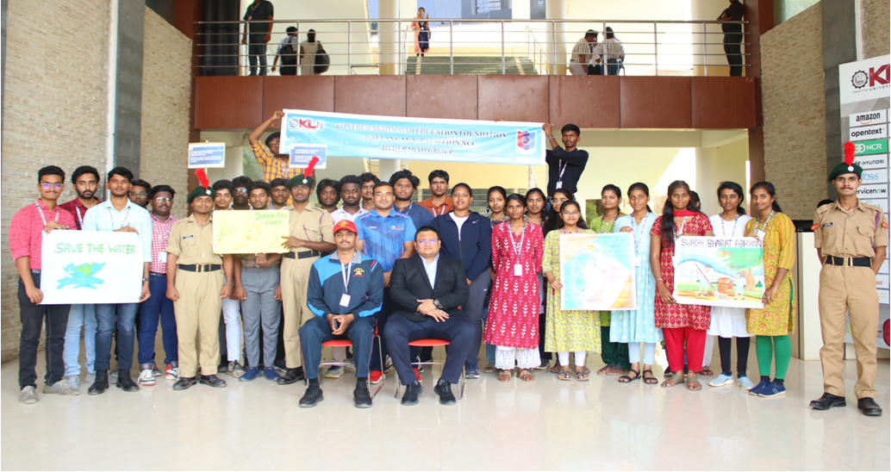
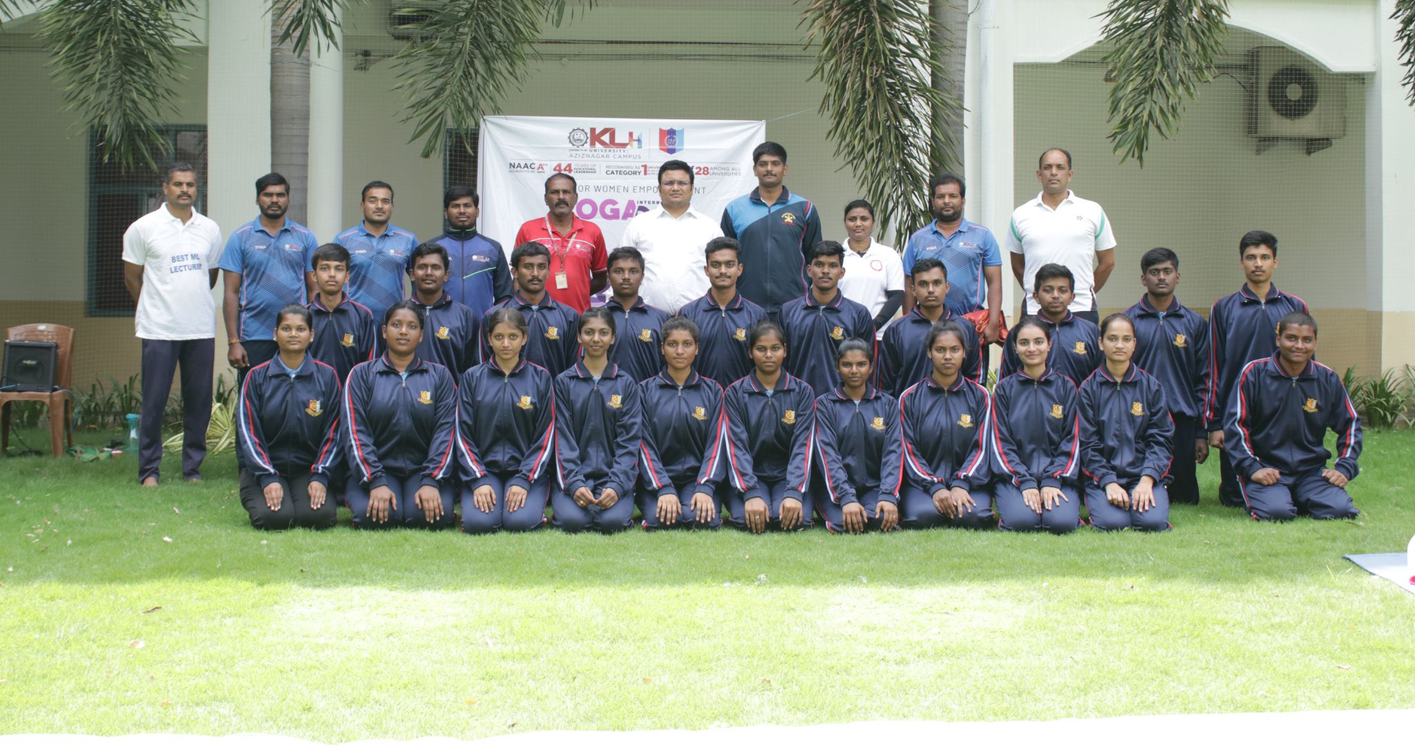
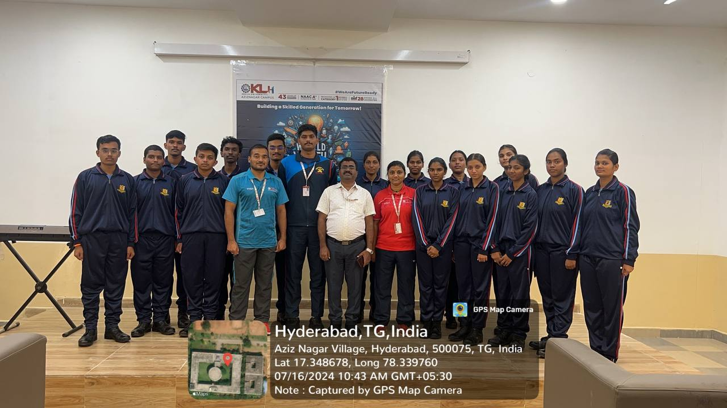
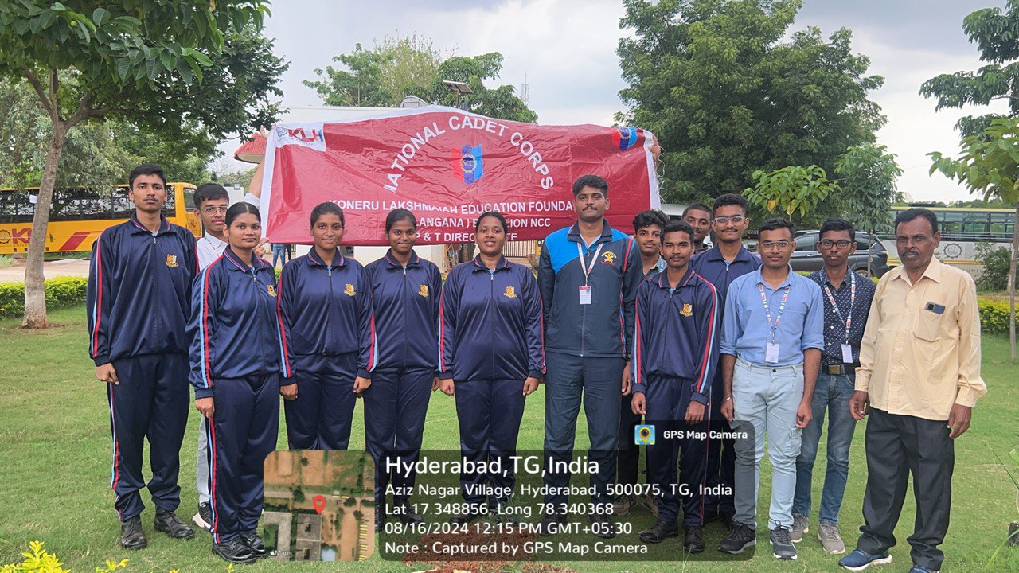
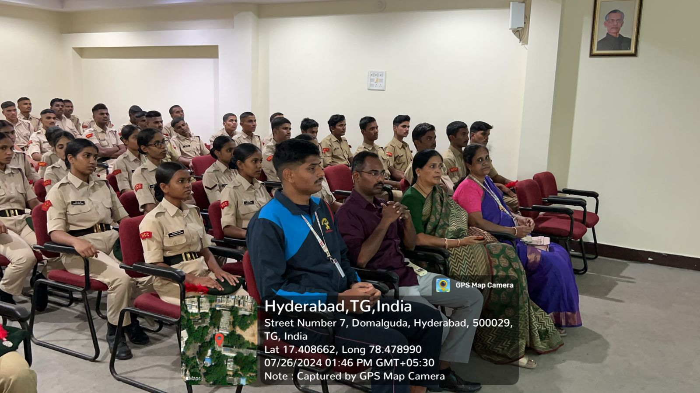
NCC ACTIVITIES AT KLH

Slide 5
Year | Enrolled +Extension | Appeared Year | B Certificate Appeared | B Certificate Passed | B Certificates% | C Certificate Appeared | C Certificate Passed | C Certificate Pass%
2023 | 55 | 2023 | The cadets are in their first year, so there is no representation in B and C Certificates due to the new raising of the unit.

